Slide 1




LE STUDIUM
NEOLAiA Visiting Researchers programme

Slide 2








Le Studium Institute for Advanced Studies
Non-profit organisation created in 1996
      Institute for Advanced Studies since 2010
International scientific exchanges through the mobility of researchers
      Open to all scientific disciplines - Transdisciplinary approach
Large panel of residency formats and events
      Actions enabling internationalisation of research projects
Development of sustainable international scientific collaborations

Slide 3






Le Studium – Actions
Develop innovative mobility and networking programmes
Select and welcome international researchers in CVL region
Lead actions for the internationalisation of research projects/programmes
Organise scientific events in a variety of formats
Provide a unique residency setting with a cross-disciplinary approach
Offer comprehensive assistance during the preparation and residency phases

Slide 4


NEOLAiA Visiting Researcher (NVR) Programme
    Bi-annual call for applications
    Open to all scientific thematics
    Open to all international experienced researchers based in an university partner of the NEOLAiA alliance
    LE STUDIUM VISITING RESEARCHER award targets experienced international researchers having and keeping a salary in their home institution and willing to join a research center at the University of Tours for a scientific residency for a period of 3 to 9 months. This programme supports the welcoming and residence in the region and the integration into the LE STUDIUM scientific community.

Slide 5
NVR Programme - Summary
Programme | Duration | Candidate | Award’s Benefits | Date of residency
Visiting Researcher | 3 to 9 consecutive months | Experienced researcher (minimum 3 years after the PhD) | - Travel cost contribution capped to 700 EUR - Furnished accommodation in a high-standard apartment in the city center of Tours - Administrative support - International scientific events - Integration into the Le Studium scientific community | Earliest starting date: September 2026

Slide 6
NVR Programme - Selection
Eligibility check by Le Studium
Evaluation, final ranking and selection by the NVR Selection Committee
    Evaluation criteria:
      Scientific Quality (50%)
      Impact of the proposed research and impact of the collaboration (25%)
      Career and Track Record of the Applicant (25%)
    NVR Selection Committee composed of:
      Representatives of the University of Tours, i.e. the Vice-President for Research, the Vice-President for International relations, the local NEOLAiA Project Manager
      1 representative of Le Studium (as observer)

Slide 7
Opportunities for awardees
    Integration in a research unit of the University of Tours
      Invitation to lead a research project
      Opportunity to give lectures at UT
      Possible co-supervision of students
    Integration in the LE STUDIUM international faculty of fellows
      Monthly interdisciplinary seminars with other international fellows
      Regular interactions with the Institute for Advanced Studies staff
    Opportunity to organise an international event (conference or workshop)
    Visit of a lovely city and a beautiful region with a strong cultural heritage (Loire Valley)

Slide 8
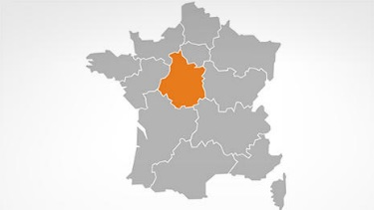
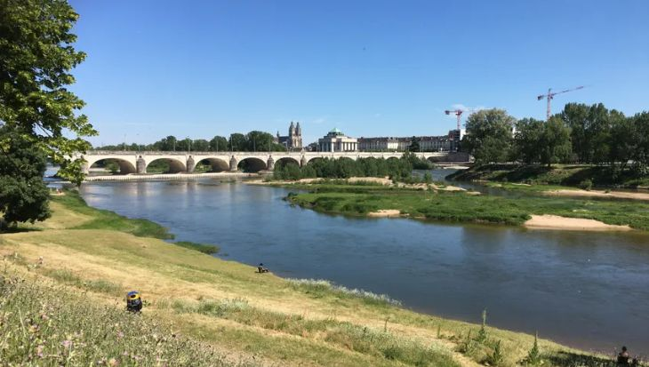
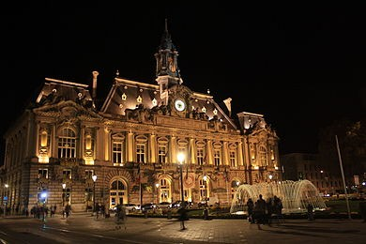
Welcoming international scientists
    A warm welcome and attentive support
    Accommodation in a pleasant area Fully-equipped flats (furniture, electrical appliances, crockery, bedding and household linen, internet, etc.)
    Contact person available for the preparation of and during the residency
    Management of administrative and logistical issues (visa, residence permit, bank, insurance, health, telephone, schooling, daycare, cultural activities, repairs, rental, etc.)

Slide 9

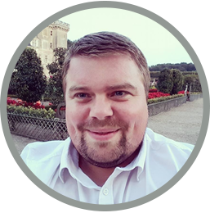
Contacts
Sophie GABILLET
Secrétaire Générale / General Secretary
sophie.gabillet@lestudium-ias.fr
Dr Aurélien MONTAGU
Scientific Manager
Responsable Scientifique
aurelien.montagu@lestudium-ias.fr
LE STUDIUM Loire Valley Institute for Advanced Studies
+33 2 38 21 14 82
http://www.lestudium-ias.com/

